Slide 1
學術研究分享
2020.08.24
朱柏賢

Slide 2

DALab

Slide 3

DALab

Slide 4
異常程式分析架構 – 以半導體封裝廠為例
2018

Slide 5
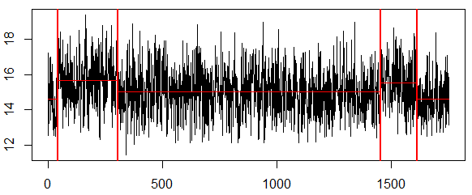
異常程式標訂
目的：由於實際生產資料未標記確切偏移點，故以人工標訂異常程式 ，以利 後續驗證。
方法：手動調整懲罰值，裁取資料區段，使一支程式只有一個明顯偏移點。
資料：20XX/XX/XX – 20XX/XX+6/XX
此處之正常與異常並不代表實際上程式之運作狀況，僅是依擷取區段判斷是否會影響後續EWMA之表現，作為參數設定的依據
原始資料
筆數> L
否
不採用
是
資料擷取區段範例
以CPA標定程式
偏移>S%
否
判為正常
模型不應偵測
是
判為異常
模型應偵測
最終測試資料

Slide 6
影響 Ball Shear 值之要素選擇
影響要素大致歸納如下：
影響BS值要素 | 原因
機型 | 機型新舊問題導致打線參數有些微不同
推球機 | 不同樓層使用之推球機不同
CID | 下列三者改變其一即更新：Sample Size改變、換廠區、 Spec 改變
管制界限 | 隨時間人為更新 (縮窄)
公司人員在後續EWMA監控機台時，僅有依照機型分類，並無將其他因素納入，故異常程式判定部分也僅納入機型。
Notes:
Spec 客戶別 線材 線徑

Slide 7
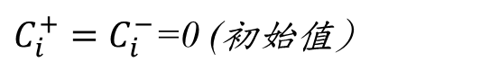

CUSUM構想
方法：利用CUSUM累加方法，驗證抓出之異常是否與先前CPA
訂定的偏移點互相印證。
Cusum 公式
參數設定
容差 k (allowance)：容許的誤差範圍，通常設定為目標值的一半。
管制界線CL (Control Limit)：超過則視為製程偏移。
容差與決定區間之設定，原皆為以資料標準差為單位進行設定，為配合以偏移百分比的計算標準，進行調整。
$$C_{i}^{+}=max⁡[0,x_{i}−\left(μ_{0}+K)+C_{i−ˊ1}^{+}\right]$$
$$C_{i}^{−}=max⁡[0, \left(μ_{0}+K)−x_{i}+C_{i−1}^{+}\right]$$
$C_{i}^{+}=C_{i}^{−}$=0 (初始值)

Slide 8
模型績效指標
以對應CPA之正確率為主、ARL為輔做排名順序
為避免 cpt 影響 ARL0 之大小，其排序以 ARL0 / cpt 作為衡量標準
平均連串長度，ARL (Average Run Length)示意圖
ARL0
cpt
資料起點
CUSUM超出管制線的1st 點
資料終點
cpt
ARL1
資料起點
CUSUM超出管制線的1st 點
資料終點
8

Slide 9
參數設定
以多種 Se.shift 及 Decision Interval 排列組合，再以K-fold交叉驗證，嘗試找出最佳參數設定
以標準差為參數
中心線(CL)：平均值
管制界限：平均值 ± k倍標準差
參數設定範圍：
Se.shift ：0.1 σ ~ 3 σ
Decision Interval ：1 σ ~ 30 σ
UCL
kσ
μ
CL
kσ
LCL
以標準差為參數之圖示

Slide 10
CUSUM參數設定
以多種 Se.shift 及 Decision Interval 排列組合，嘗試找出最佳參數設定
將各參數組合之 ARL0 及 ARL1 分別做排名，相加後為總排名之依據
為避免 cpt 影響 ARL0 之大小，其排序以 ARL0 / cpt 作為衡量標準
可依 ASE 意願決定 ARL0 及 ARL1 之權重 (此版為 1:1)
以正確率為主、ARL為輔做排名順序
以標準差為參數
中心線(CL)：平均值
管制界限：平均值 ± k倍標準差
參數設定範圍：
Se.shift ：0.1 σ ~ 2 σ
Decision Interval ：1 σ ~ 25 σ
UCL
kσ
μ
CL
kσ
LCL
以標準差為參數之圖示

Slide 11
總結
模型建立流程
建立異常程式分析架構 (上線流程)
原始資料
即時更新資料
筆數> L
否
不採用
將程式依機型分類
是
以CPA標定程式
放入CUSUM偵測
偏移>S%
否
判為正常
模型不應偵測
超出管制界限
否
是
納入EWMA機台控管
判為異常
模型應偵測
是
屏蔽超出
管制界限之後區段
屏蔽後之正常資料
最終測試資料
最佳參數測試
公司人員查明原因後修正
Notes:
正確率96%

Slide 12
UNISON data-driven intermittent demand forecast framework to empower supply chain resilience and an empirical study in electronics distribution
2019

Slide 13
Understand and define the problem
To fulfill the demands of downstream customers globally, semiconductor component distributors are supposed to maintain inventory management weekly based on future demand predictions for different product characteristics to maintain customer service levels and merge the separated forecasts into replenishment orders for upstream manufacturing factories.
Construct an appropriate automated forecast mechanism for semiconductor components with regard to the distinct dynamics of diversified demand features.

Slide 14
Structure influence relationship
To reduce the temporal effect on demand uncertainty, the proposed approach transforms the original demand into several time series with different aggregation levels.
At each sub-aggregated forecast stage, three demand forecast models with respective characteristics are occupied as decision strategies.
The weighted combination schema based on the decision regret is adopted for forecast combination at sub-aggregated levels.
Finally, the forecast results at different aggregation levels are integrated by the disaggregation procedure to generate a unique forecast result.

Slide 15
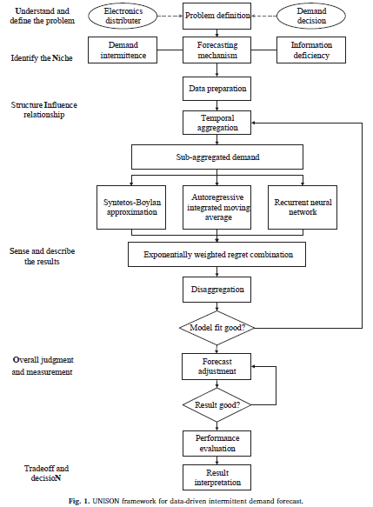

Slide 16
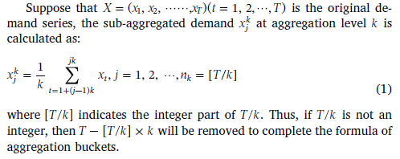
Temporal aggregation

Slide 17
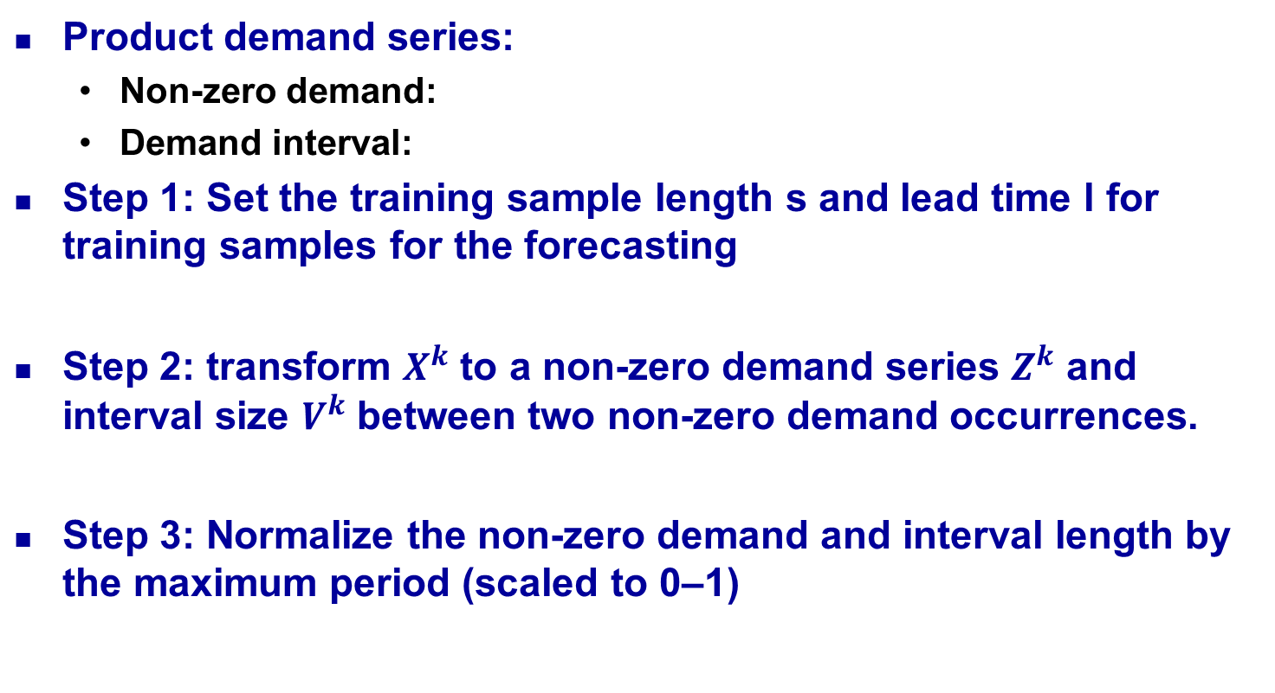
Sub-aggregated demand forecast

Slide 18
Sub-aggregated demand forecast
Step 4: Forecast the non-zero demand Z and interval V by three individual forecast models in representation of Croston variants, time series and machine learning forecast approaches with adaptive trained parameter settings constants.

Slide 19
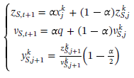
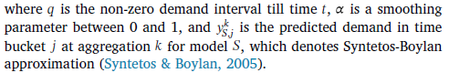
Sub-aggregated demand forecast
Syntetos-Boylan approximation (2005)

Slide 20
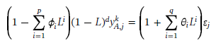
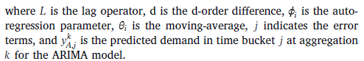
Sub-aggregated demand forecast
ARIMA (p, d, q): 差分整合移動平均自迴歸模型

Slide 21
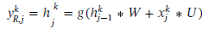
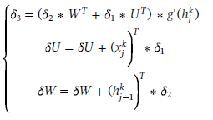
Sub-aggregated demand forecast
Recurrent neural network (RNN)
Input series:
Hidden layer vector:
Predicted result:
RNN unit is computed as:
Back-propagation

Slide 22
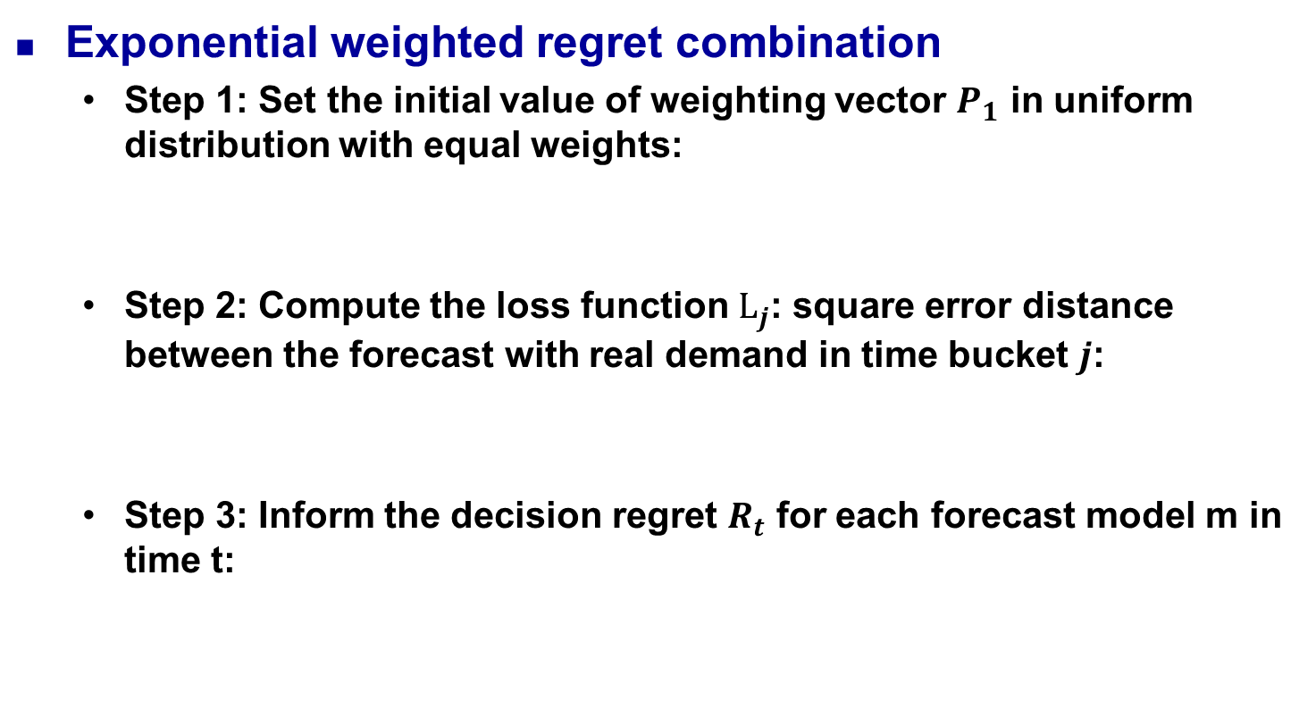
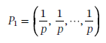
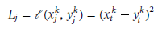
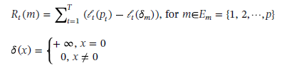
Sense and describe the results

Slide 23
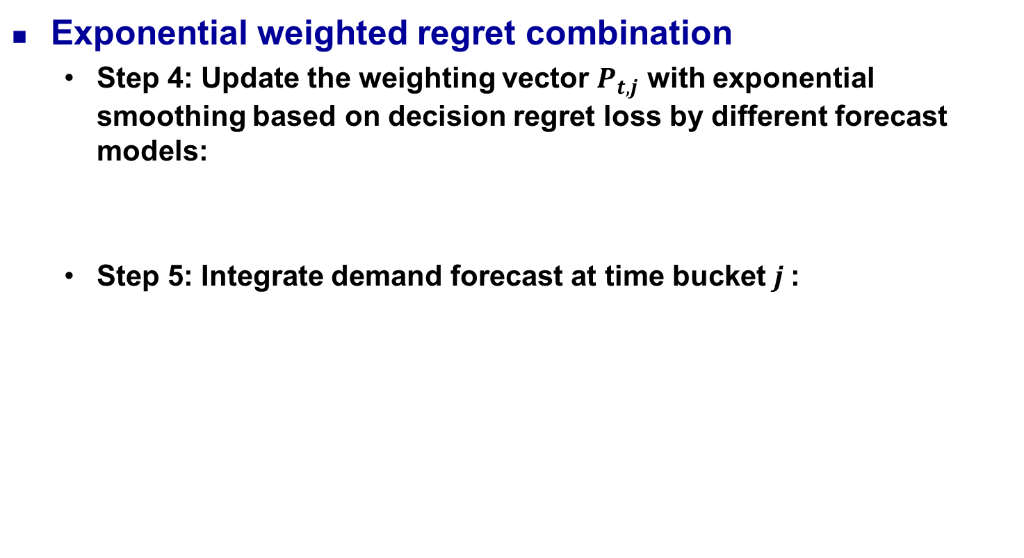
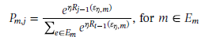
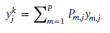
Sense and describe the results

Slide 24
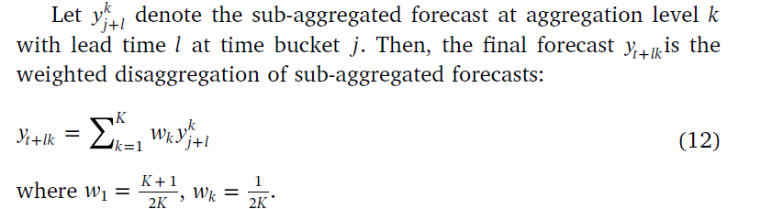
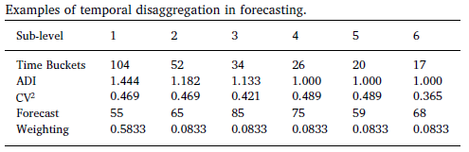
Sense and describe the results
Disaggregation

Slide 25
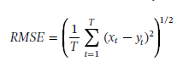
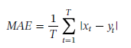
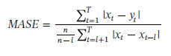
Overall judgement and measurement
RMSE:
MAE:
MASE

Slide 26
Empirical Study
Understand and define the problem
This study conducts an empirical study in a worldwide leading electronics distributor to validate the model effectiveness
Identify the niche
The empirical dataset includes a set of 265 products recorded for 104 weekly demand observations in three warehouses
23 component demand series with less than the in-sample baseline (5 pick-up points) for model fitting are removed from our experiment and the remaining 242 are separated into two parts: 78 observations for training and the remaining 26 for testing

Slide 27
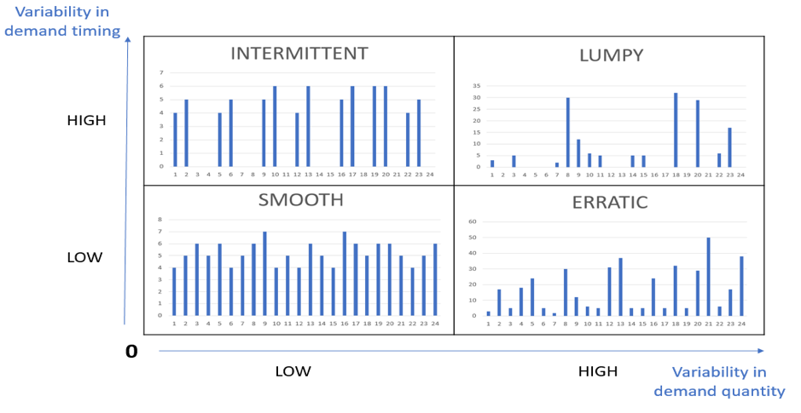
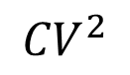
Empirical Study
Identify the niche
ADI
110
85
1.32
4
43
0.49

Slide 28
Empirical Study
Sense and describe the results
This study employs temporal aggregation and disaggregation to diminish the abnormally massive impact of unexpected event effects in different temporal segments
This study sets the aggregation level equal to the lead time in temporal aggregation stage
Three forecast horizons are considered in the experiment test: 4-periods for rush orders, 8-periods for regular orders, and 12-period lead time for customized orders

Slide 29
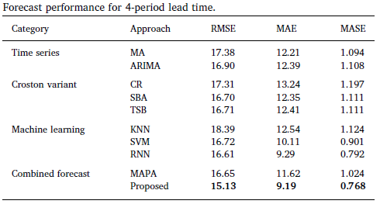
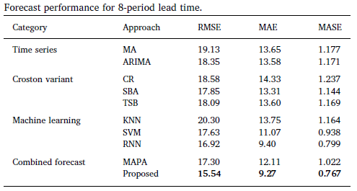
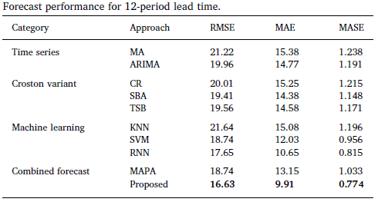
Empirical Study
Overall judgement and measurement

Slide 30
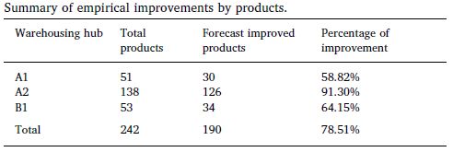
Empirical Study
Overall judgement and measurement

Slide 31
Empirical Study
Trade-off and implement the optimal decision
The results in empirical study have shown that the proposed approach can effectively handle general intermittent patterns such as product life cycles and periodic event effects of component transaction to support inventory decisions
Improve supply chain efficiency, reduce accumulated inventory, and finally reduce operating costs.

Slide 32
Conclusion
This study developed a novel data-driven demand forecast framework that can integrate temporal aggregation with time series and neural network for intermittent component demand forecast to support smart production for global manufacturing networks
More studies can also be conducted with further internal and external information to enhance the accuracy and generalizability of the forecast results

Slide 33
Manufacturing intelligence for semiconductor demand forecast based on technology diffusion and product life cycle
2019

Slide 34
Introduction
Semiconductor manufacturing companies have to forecast future demands to provide the basis for manufacturing strategic decisions including new fab construction, technology migration, capacity transformation and expansion, tool procurement, and outsourcing.
It is critical for high-tech industry to develop flexible forecasting systems that allow them to quickly respond to mitigate the negative impacts of the Bullwhip Effect.
Demand fluctuation due to shortening product life cycle and increasing product diversification in the consumer electronics era make the demand forecast problem increasingly difficult and complicated.

Slide 35
Introduction
These time series methods have difficulty for expressing the adoption process of new products. In addition, forecasting methods that are designed for a single generation cannot consider inter-generational substitution involved in semiconductor industry.
SMPRT model based on product life cycle and technology diffusion theories, for forecasting semiconductor product demand, in which the seasonal factor(S), market growth rate(M), price(P), repeat purchases(R), technology substitution(T) are considered.

Slide 36
Fundamental
Bass model
A basic diffusion model for new consumer durables to forecast the sales of the new product with the first purchase
Divided the adopters into two groups
First group : innovators who adopt the product via mass media communications
Second group : imitators who adopt the product via word of mouth communications.

Slide 37
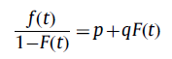
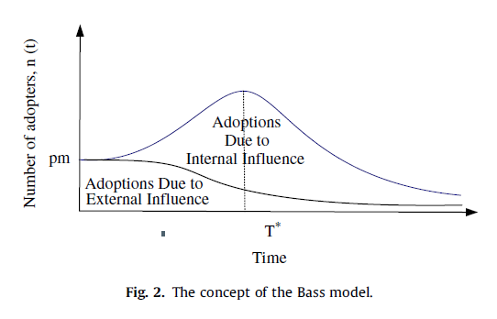
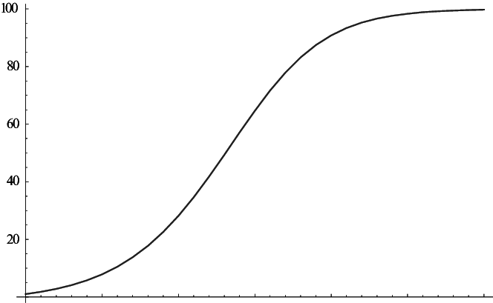
Fundamental
Bass model
f(t) : probability destiny function of adopters at time t
F(t) : cumulative destiny function of adopters at time t
p : coefficient of innovation (external coefficient)
q : coefficient of imitation (internal coefficient)

Slide 38
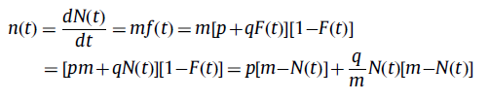
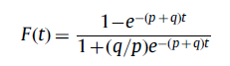
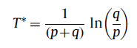
Fundamental
Bass model
m : market potential
n(t) : number of adopters at time t
N(t) : cumulative number of adopters at time t

Slide 39
Fundamental
Multi-generation diffusion model
Norton and Bass (1987) extended it into a multi-generation diffusion model for high-tech products.
Bass model assumes:
(1) the existence of a series of advancing generations, each of which with functions equaling or exceeding those of the previous generation
(2) a function of time to the adoption for each generation applied against a time-varying market potential
(3) the substitution of actual and potential sales from earlier to later generations

Slide 40
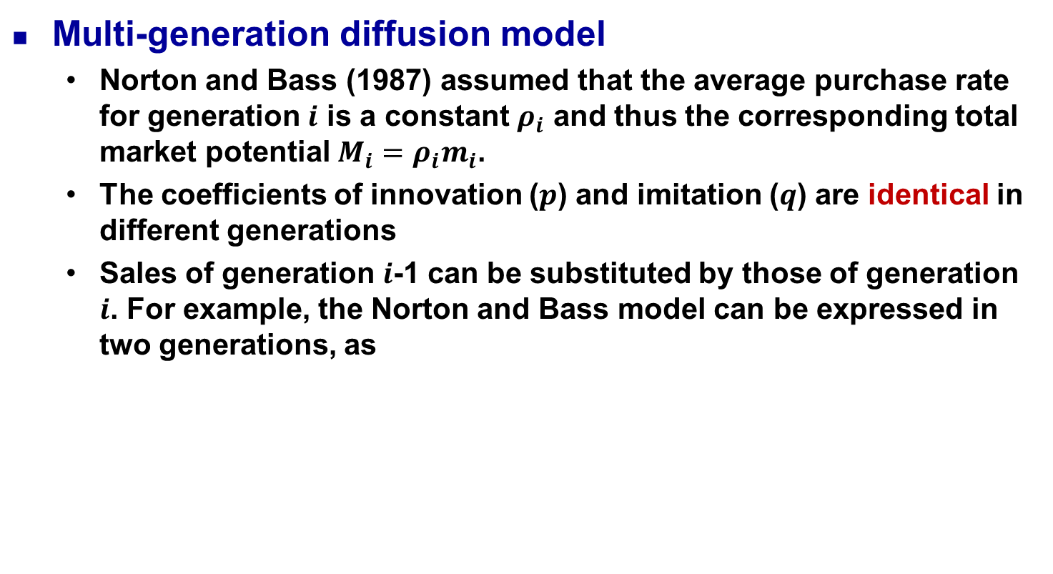
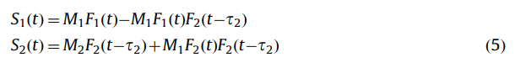
Fundamental

